Slide 1
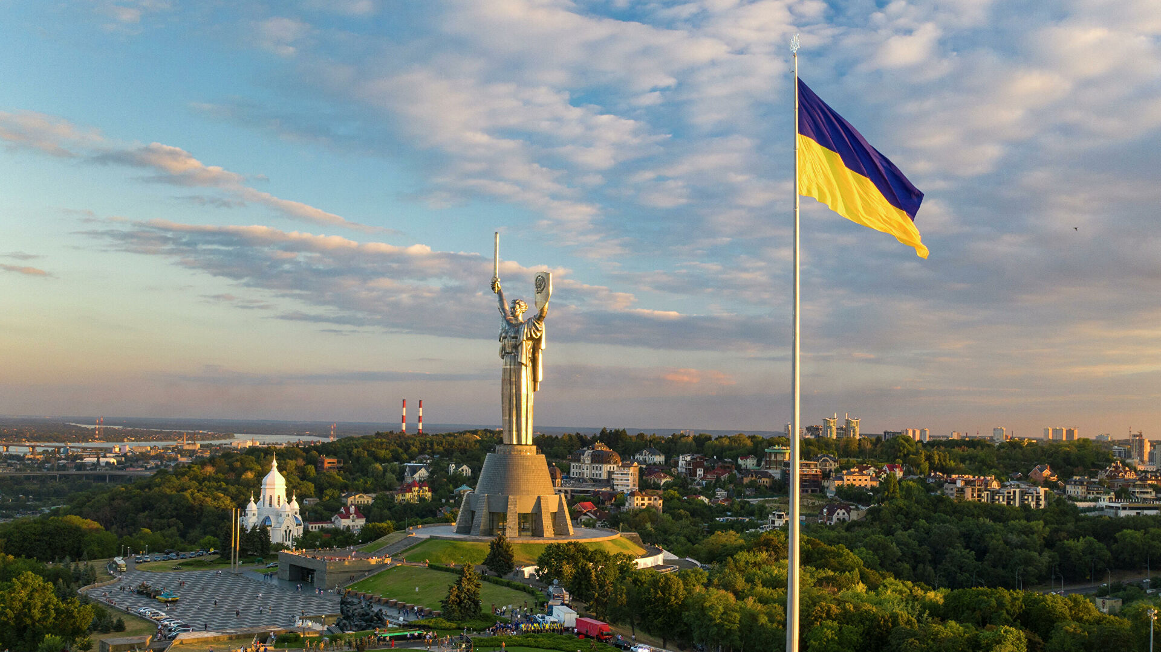
Ukrainian state
The presentation was prepared by:
Saveliev A. A., Dean of the Educational Institute of Foreign Citizens Training
Kunitsyn M. V., Deputy Dean of the Educational Institute of Foreign Citizens Training

Slide 2
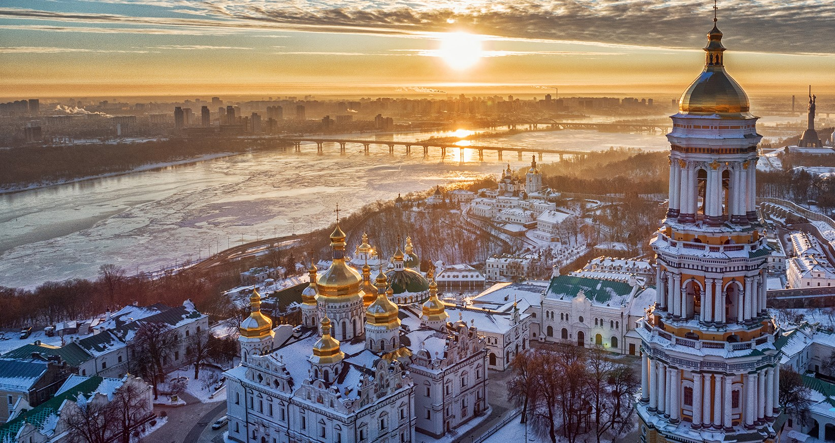
01
02
03
04
Ukrainian state
Administrative structure of Ukraine
The oldest cities in Ukraine
Religion in Ukraine

Slide 3
Ukrainian state

Slide 4
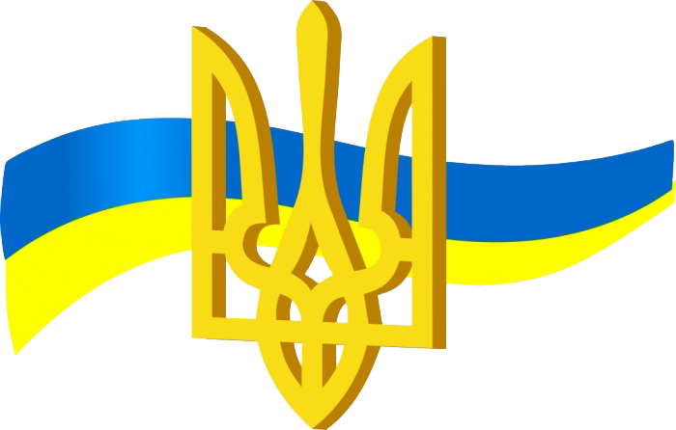
Ukrainian state
Ukraine is a country in Eastern Europe. Its territory is 603,549 square kilometers. In terms of territory, it ranks second after Russia among European countries.

Slide 5
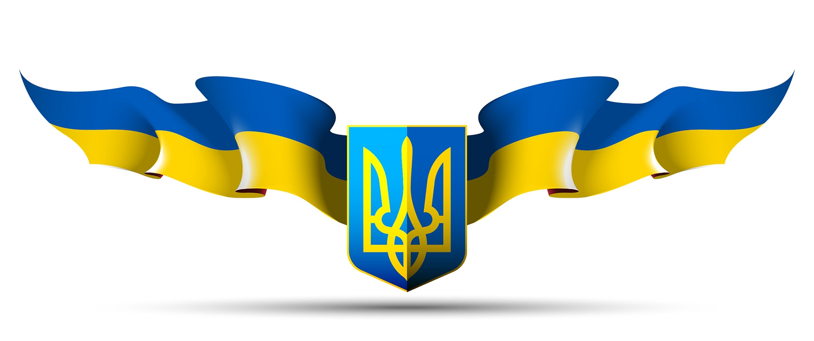
Ukrainian state
On August 24, 1991, Ukraine declared independence.
The full name of the country is the Republic of Ukraine.

Slide 6
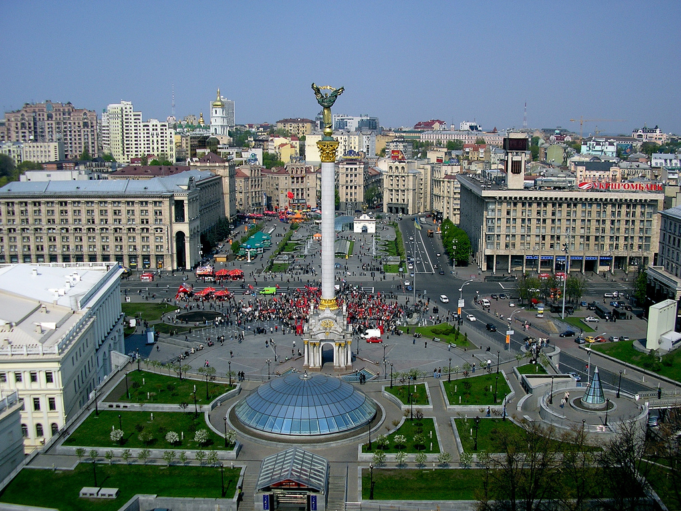
The capital of Ukraine is Kyiv

Slide 7
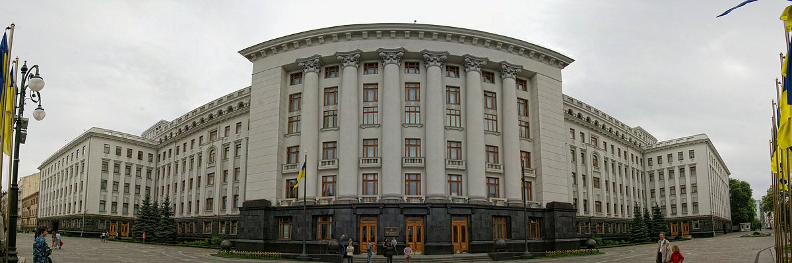
Ukrainian state
Since 2014-a, a parliamentary-presidential republic.
The head of state has been the president.
The president is elected for five years.
The Government Of Ukraine - Cabinet Of Ministers.
The head of government is the Prime Minister.
The Verkhovna Rada of Ukraine is the legislative power of the country.

Slide 8
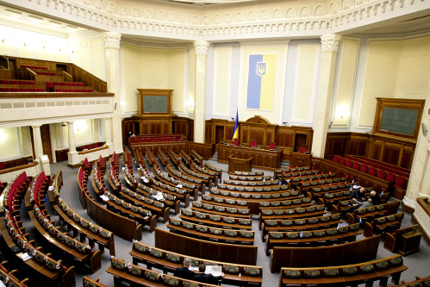
Ukrainian state
The Verkhovna Rada of Ukraine is the legislative power of the country.
The Verkhovna Rada consists of 450 deputies.

Slide 9
Administrative structure of Ukraine
And Million-plus cities

Slide 10
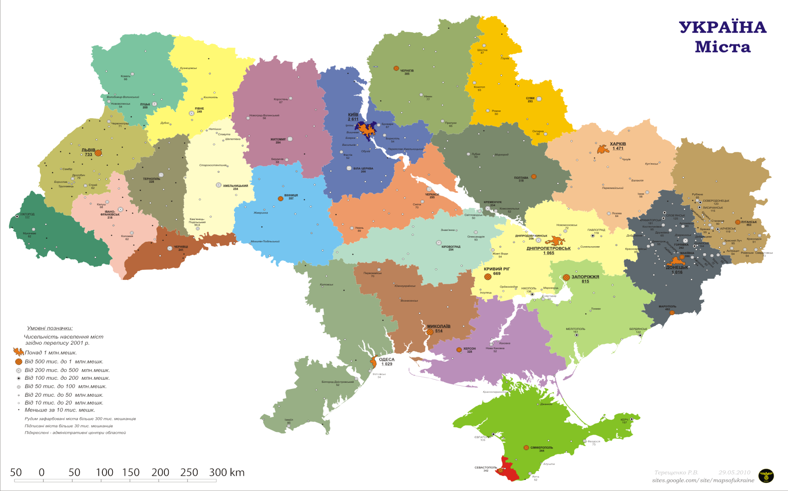
Ukraine includes 24 regions and the Autonomous Republic of Crimea.
Ukraine is divided into five regions – Western, Northern, Eastern, Southern, and central Ukraine.
There are 459 cities in Ukraine.

Slide 11
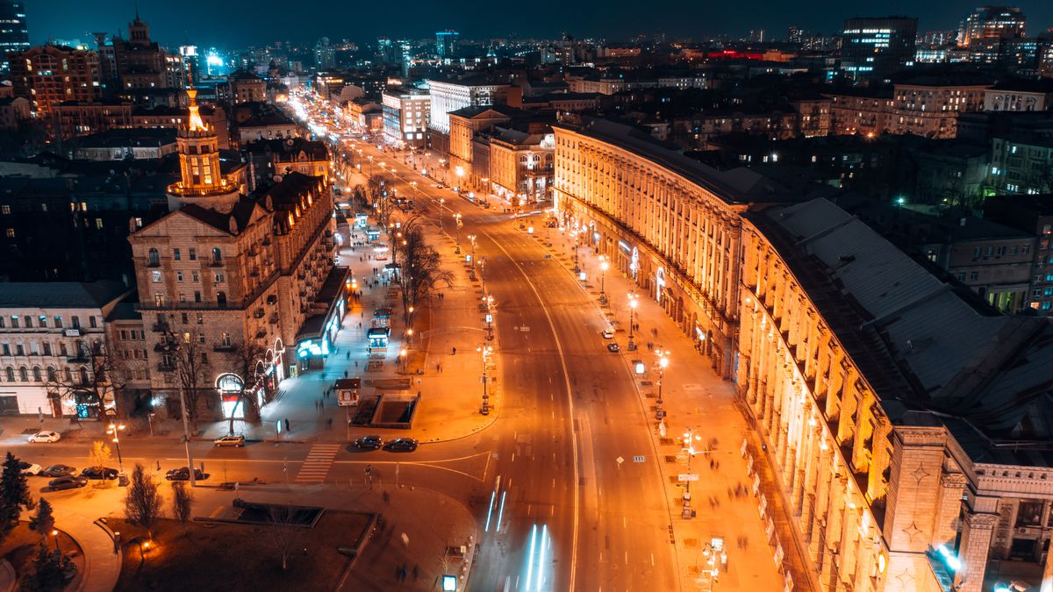
Million-plus cities: Kiev

Slide 12
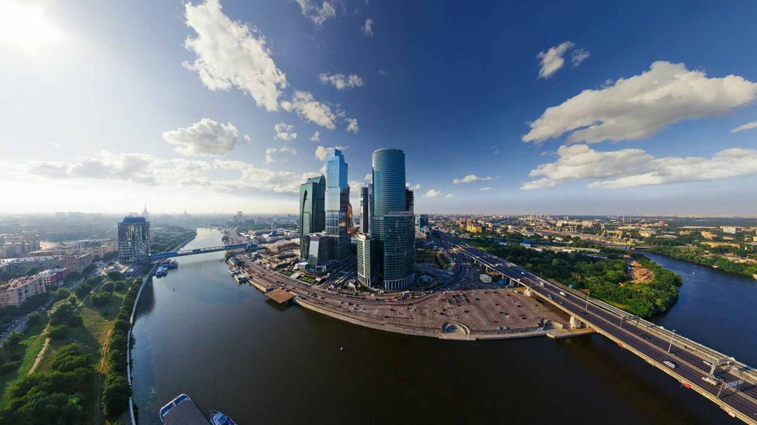
Million-plus cities: Dnipro

Slide 13
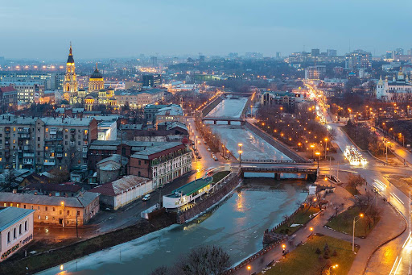
Million-plus cities: Kharkiv

Slide 14
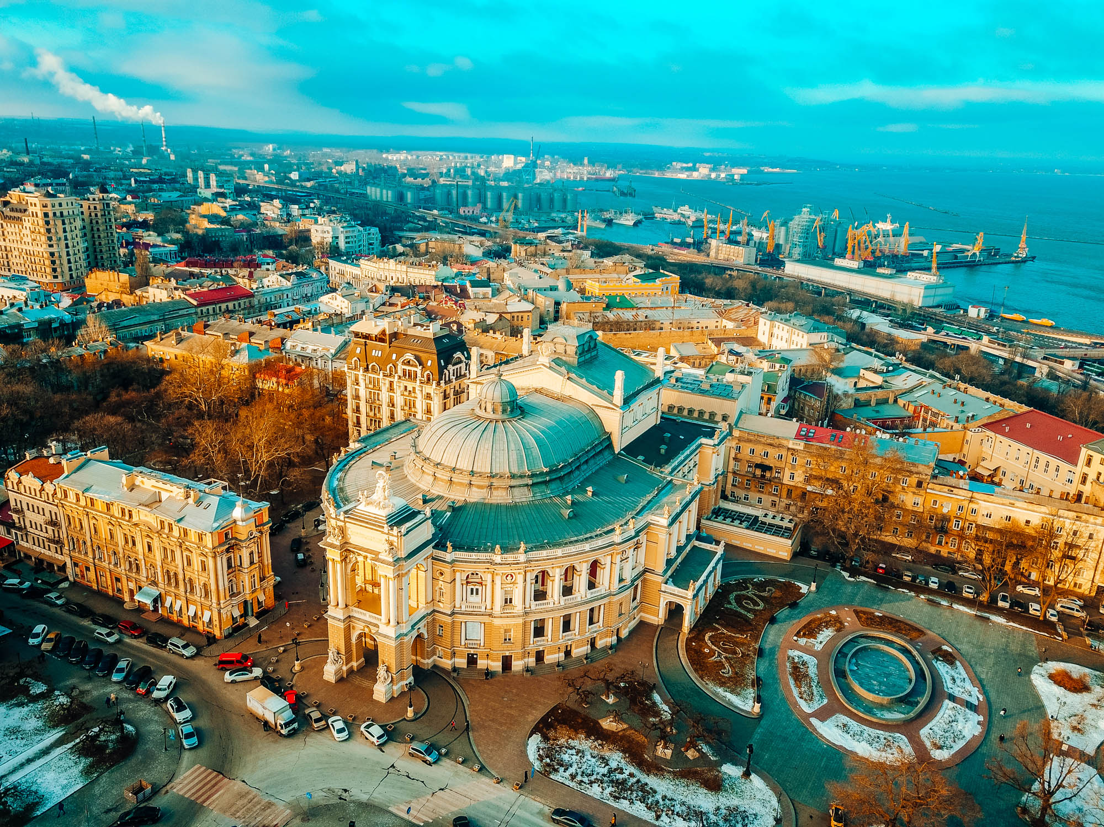
Million-plus cities: Odessa

Slide 15
The oldest cities in Ukraine

Slide 16
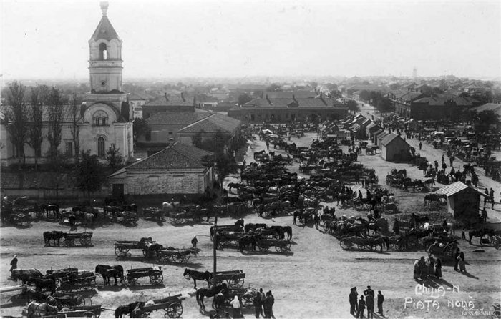
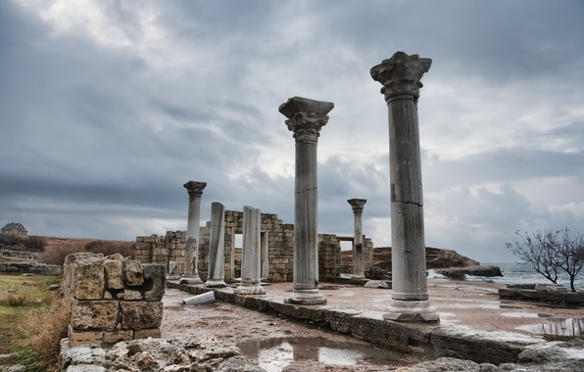
Chersonesos - date of origin in 424/421 BC.
Kilia is the oldest city in Ukraine. It is 2,700 years old.

Slide 17
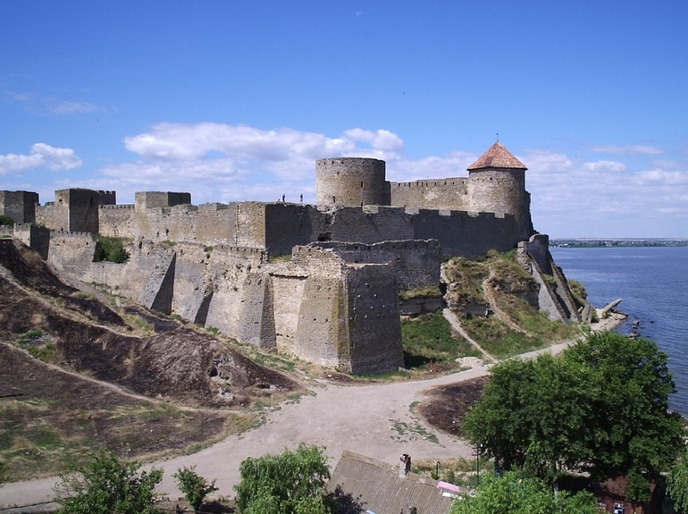
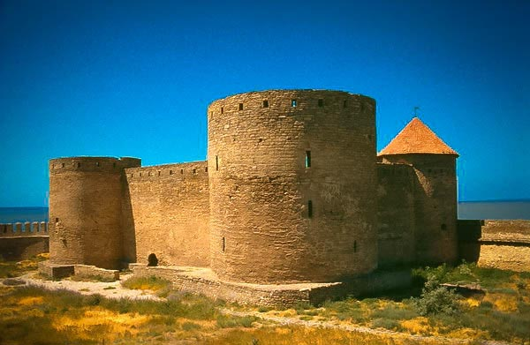
Belgorod-Dniester - 2500 years old.

Slide 18
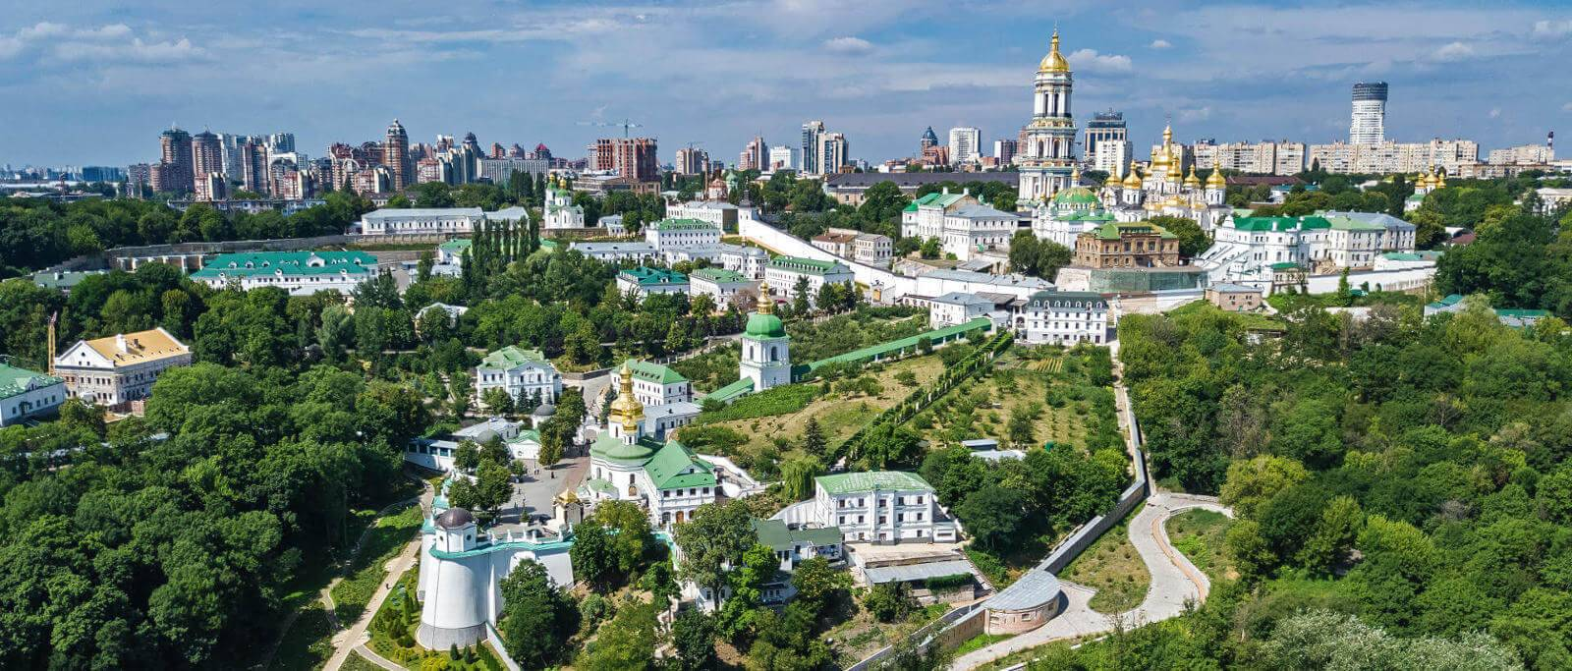
The date of the foundation of Kyiv is 482.
Thus, Kyiv is more than 1500 years old.

Slide 19
Religion in Ukraine

Slide 20
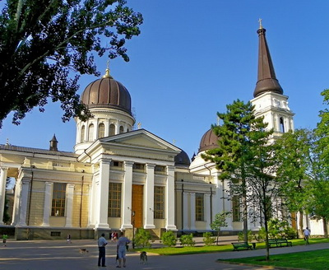
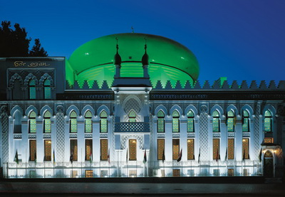
Orthodox Christians, Catholics, Muslims, Jews, etc., live in Ukraine. However, the absolute majority of the population (more than 88%) are Christians.
Spaso-Preobrazhensky Cathedral
Arab Center

Slide 21
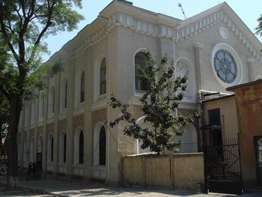
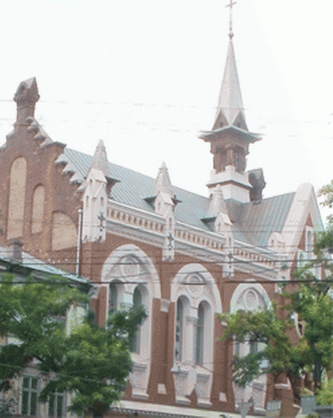
Ukraine is a secular state, and the country's Constitution guarantees freedom of religion.
Protestant church
Odessa synagogue

Slide 22
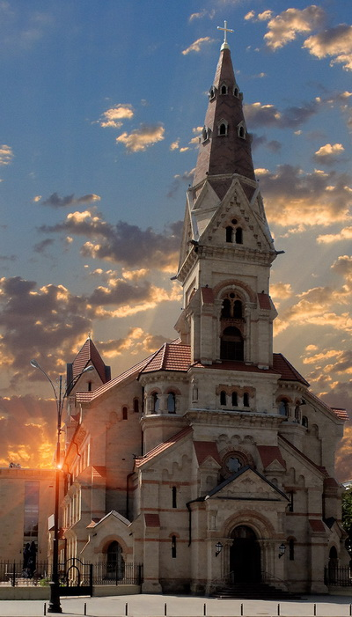
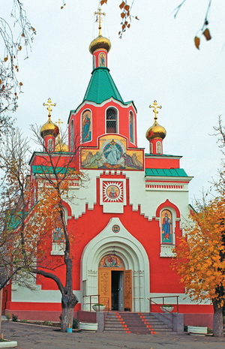
Church-Lutheran Cathedral of St. Paul
Church of St. Mary Magdalene

Slide 23



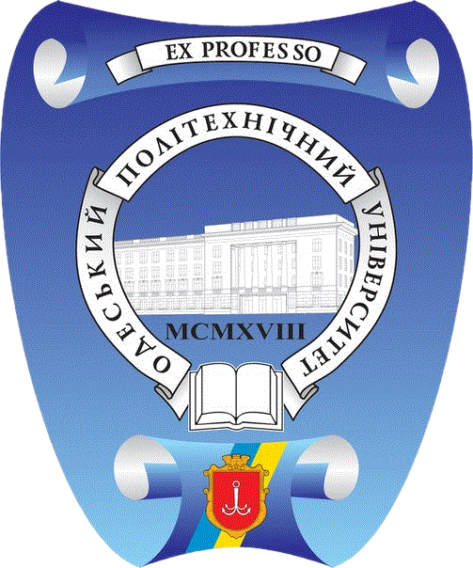

THANKS
Does anyone have any questions?
Follow Us on Social Media
dec.ipig@opu.ua
opu.ua
fspirki.opu.ua
facebook.com/IPIG.ONPU
Project manager: lebedmy@gmail.com
The presentation was prepared by:
Saveliev A. A., Dean of the Educational Institute of Foreign Citizens Training
Kunitsyn M. V., Deputy Dean of the Educational Institute of Foreign Citizens Training

